Slide 1
Watershed Planning for Climate Change: Basic Approach and Resources
By Tamatha Patterson and Kelsey Thetonia
Indiana Watershed Leadership Academy
May 20, 2015

Slide 2
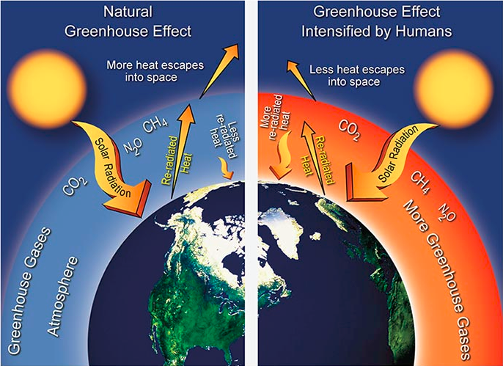

Slide 4
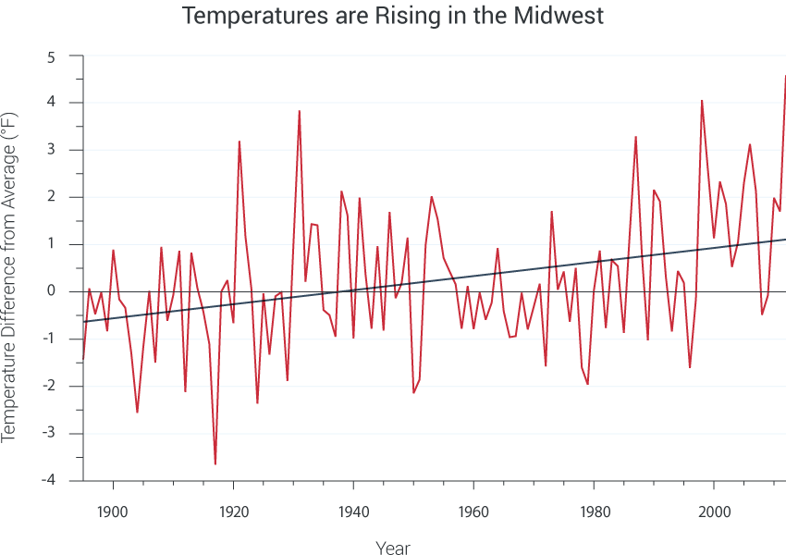
IMPLICATIONS OF CLIMATE CHANGE
globalchange.gov
Notes:
Rising Temperatures
Increasing length of frost-free season

Slide 5
IMPLICATIONS OF CLIMATE CHANGE
Changes in precipitation patterns
Increasingly heavier precipitation events

Slide 6
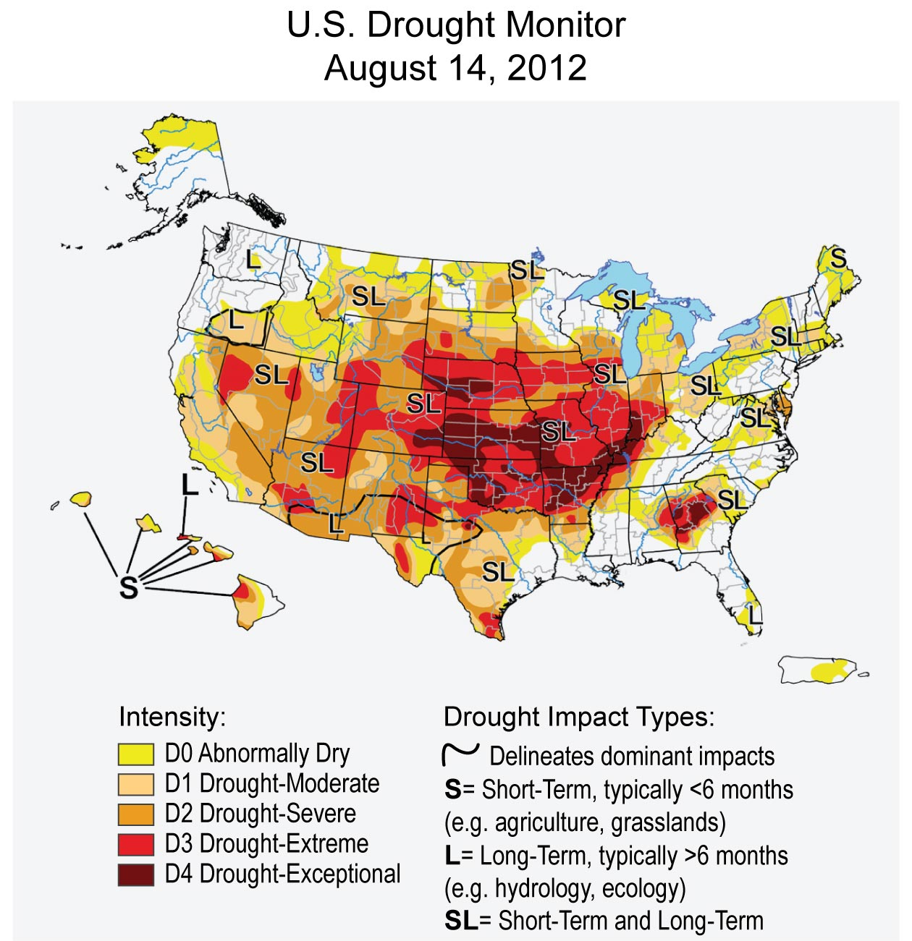
IMPLICATIONS OF CLIMATE CHANGE
Notes:
Increasing occurrence of extreme weather events (heat waves, cold waves, floods, and droughts)

Slide 7
IMPLICATIONS OF CLIMATE CHANGE
Increasing intensity, frequency, and duration of hurricanes
Increasing intensity and frequency of winter storms
Notes:
Other trends in severe storms including tornadoes, hail, and thunderstorms is still uncertain

Slide 8
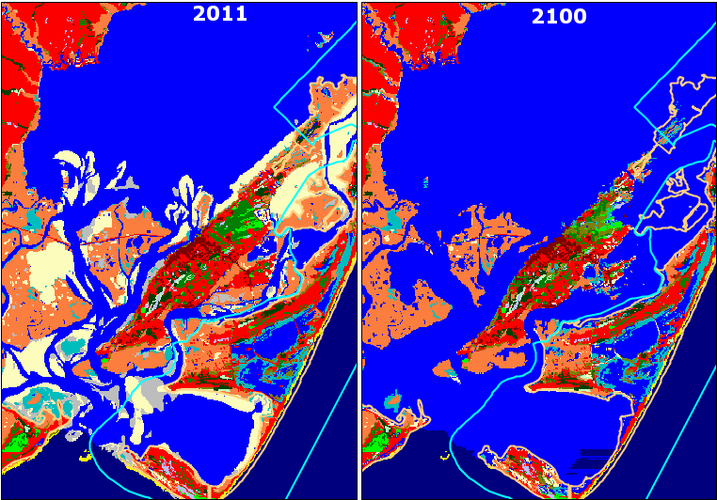
IMPLICATIONS OF CLIMATE CHANGE
Melting ice and rising sea level
Ocean acidification
SLAMM ©

Slide 9
NATIONAL CLIMATE ASSESSMENT
Summarizes the impacts of climate change on the United States
Breaks down discussion into sectors, regions, and response strategies
Elective Module Exercise 1A: Read the Introduction to the report

Slide 10
NATIONAL CLIMATE ASSESSMENT
Elective Module Exercise 1B: Choose one of the sectors to read and reflect on how this information applies to your watershed
Choices include:
Water
Energy
Transportation
Agriculture
Forests
Ecosystems
Human Health
Energy, Water, and Land
Urban
Indigenous Peoples
Land Use and Land Cover Change
Rural Communities
Biogeochemical Cycles
Notes:
Optional reading – Midwest section under ‘Regions’

Slide 11
WATERSHED PLANNING
Must include mitigation and adaptation of climate change to be effective
Notes:
Once you begin to think about the large-scale effects of climate change on your particular area/county/watershed, you then need to consider your ‘response strategies.’ This next exercise will take you to the final section of the report, called ‘Response Strategies.’ When we narrow our focus to look at response strategies for planning within your own watershed, we must include both ‘mitigation’ and ‘adaptation’ strategies.

Slide 12
WATERSHED PLANNING
MITIGATION:
Human interventions to reduce the sources of greenhouse gases or enhance the sinks that remove them from the atmosphere (US CCSP, 2009)

Slide 13
WATERSHED PLANNING
ADAPTATION:
Adjustments in natural or human systems in response to actual or expected climatic stimuli or their effects, which minimize harm or take advantage of beneficial opportunities (IPCC, 2011)

Slide 14
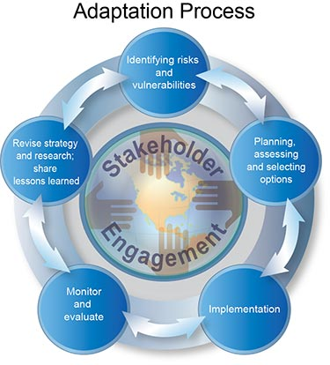

Slide 15
ADAPTIVE ANALYSIS
Assess Vulnerability
Measure Impacts
Develop and Evaluate Strategies
Implement Under Uncertainty
Notes:
There is no standard method for assessing potential climate change impacts and adaptive capacity, but a four-step process of Adaptive Analysis provides a framework

Slide 16
1. ASSESS VULNERABILITY
Identify the region-specific water resources (including source areas for imported water) that are potentially vulnerable to climate change in a way that is both significant for the stakeholders involved and measurable in some way

Slide 17
2. MEASURE IMPACTS
Quantify the climate change impacts to a region’s most vulnerable water resources.
This step can be highly analytical or qualitative, depending on the estimated level of vulnerability and system, operational complexity, and resources available for the analysis.
Notes:
To the extent appropriate..

Slide 18
3. EVALUATE STRATEGIES
Compare and rank existing and potential resource management strategies based on their effectiveness in mitigating and adapting to climate change impacts.
New or potential projects or programs may be identified during this step of the process.
Notes:
Evaluating strategies for climate change adaptive capacity is an important component of the overall evaluation of individual strategies or projects as well as integrated project portfolios, in any IRWM planning process

Slide 19
4. IMPLEMENT UNDER UNCERTAINTY
Incorporate regional management strategies into a broader planning context that considers the uncertainties associated with climate change.
Notes:
Uncertainty influences every step of a planning process involving climate change, including methods for climate change impact measurement, project selection, implementation, and performance monitoring.

Slide 20
OTHER RESOURCES
California Climate Change Handbook for Regional Water Planning
Great Lakes Climate (webinars, resources)
Climate Change: How will you manage stormwater runoff?
Climate Change Webinars from OSU
Climate Analog Tracker: Where will the world’s climates go with global warming?

Slide 21
CLIMATE ANALOG TRACKER

Slide 22
WATERSHED PLANNING FOR CLIMATE CHANGE
Many of the BMPs watershed managers promote for conservation already aim to mitigate and adapt to the effects of climate change in some way.
Watershed managers will need to adapt BMPs to changes in localized conditions over time.

Slide 23
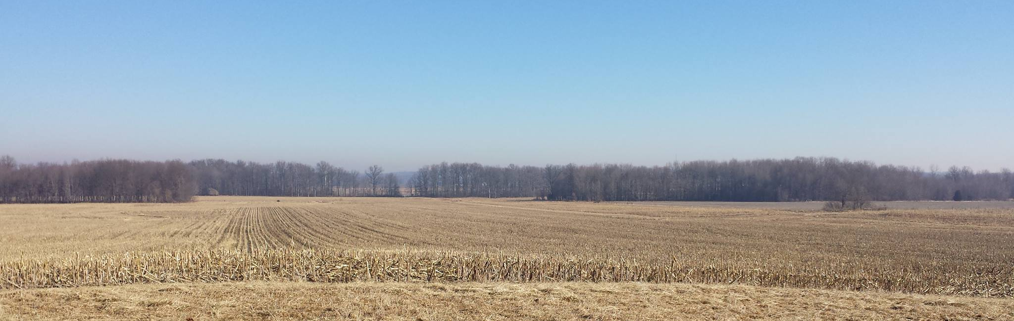
WATERSHED PLANNING FOR CLIMATE CHANGE
Watershed managers must take climate change into consideration when creating long-term plans

